Slide 1
Module Title: Project Management and Research Methodology
Module Code: IS4S706
Enhancing Phishing Detection Accuracy: A Lightweight Domain-based Approach Using Supervised Machine Learning
Submitted By
SHOHAG MIA
Student ID - 30107619

Slide 2
CONTENTS
PHISHING TRENDS AND LIFE CYCLE
THESIS
METHODOLOGY
2
4
THESIS
OBJECTIVE
1
3
5
PHISHING DEFINITION
FINDINGS AND FUTURE WORK

Slide 3

PHISHING DEFINITION
Phishing is a type of cyberattack that uses fraudulent emails, text messages, phone calls or websites to trick people into sharing sensitive data, downloading malware or otherwise exposing themselves to cybercrime.
MOST COMMON TYPES OF PHISHING ATTACKS USED AGAINST INDIVIDUALS OR BUSINESSES

Slide 4
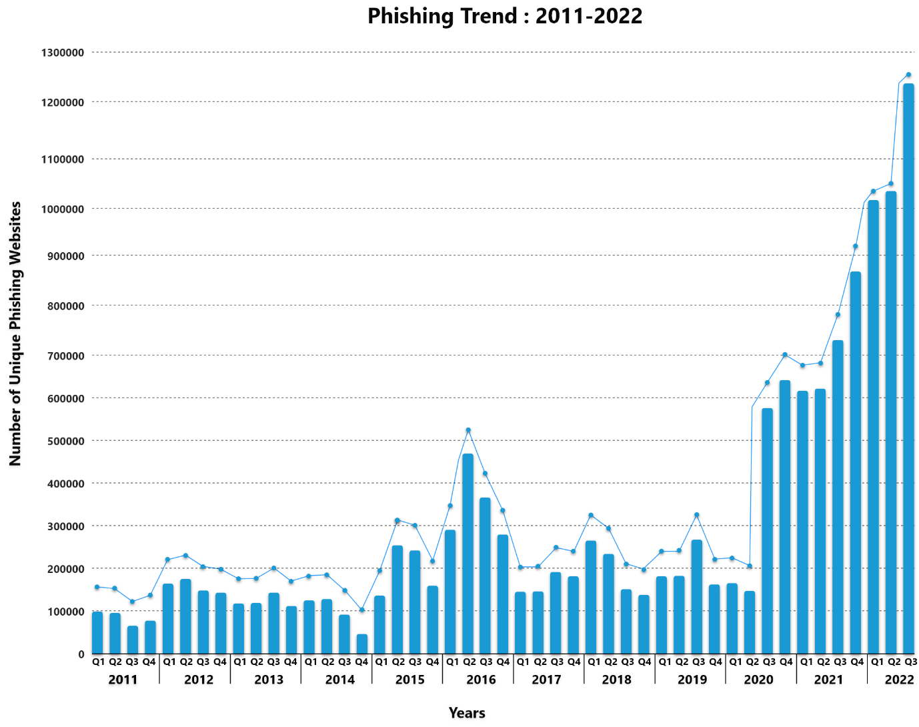
PHISHING TRENDS

Slide 5
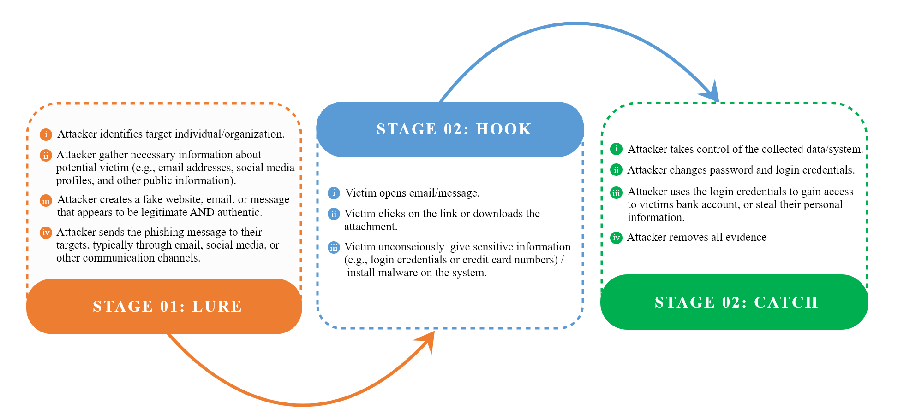
PHISHING LIFE CYCLE

Slide 6


WHICH ONE IS PHISHING (FAKE WEBTIES)?
https://web.facedook.com/
https://web.facebook.com/

Slide 7
THESIS OBJECTIVES
Conduct a comprehensive literature review to identify current phishing detection techniques, their limitations, and areas for new contributions.
Collect a comprehensive dataset of phishing and legitimate URLs from credible and reliable online sources (e.g., OpenPhish, DomCop).
Extract relevant features (e.g. domain properties) indicative of phishing attempts based on previous studies and URLs analysis.
Clean and prepare the extracted data for optimal machine learning model performance.
Explore, evaluate, and fine-tune various supervised machine learning algorithms to determine the most effective one for phishing detection.

Slide 8
LITERATURE REVIEW
Phishing Detection Techniques
Visual-Similarity / Content-Based Approaches : Detect phishing by analyzing the visual and content-based features of websites (logos, HTML, images, CSS, DOM).
Working Principle: Compare the visual elements and structural features of a website to legitimate counterparts to detect phishing attempts.
Strengths: High accuracy in recognizing visual mimicry (e.g., 99.95% in Chen et al., 2020).
Limitations: Fails with dynamic DOMs, image-only sites, and multi-language content.
Rule-Based / Heuristic-Based Approaches: Uses predefined "if-then" rules derived from known phishing sites to detect future attacks.
Working Principle: Rules are applied to site features like URLs, links, and content behavior to flag phishing attempts.
Strengths: Simple, easy to implement; decent accuracy (96.8% in Adewole et al., 2019).
Limitations: Cannot adapt to evolving phishing tactics; struggles with incomplete or ambiguous data.
Machine Learning (ML)-Based Approaches: Utilizes supervised or deep learning algorithms to identify phishing through data patterns.
Working Principle: Trains models on large datasets of phishing/legitimate sites using features like URLs, text, and DOM structures.
Strengths: High accuracy (e.g., 99.13% in Pandey & Mishra, 2023); can adapt to new data.
Limitations: High computational cost; requires large, diverse training datasets for optimal performance.

Slide 9
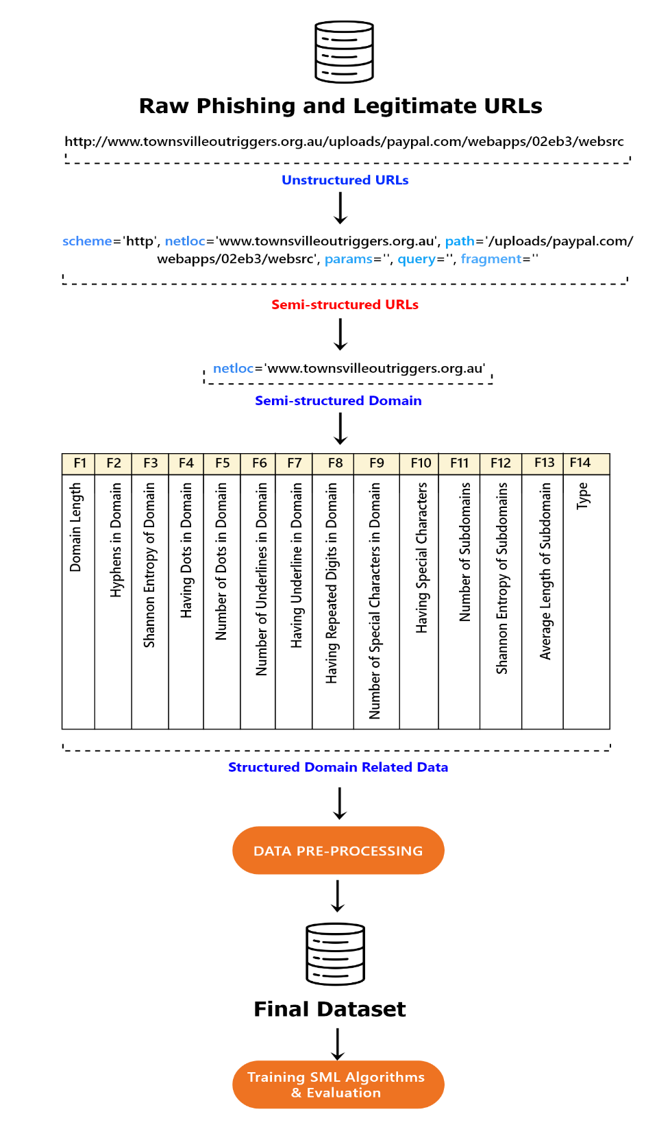
METHODOLOGICAL
FRAMEWORK

Slide 10
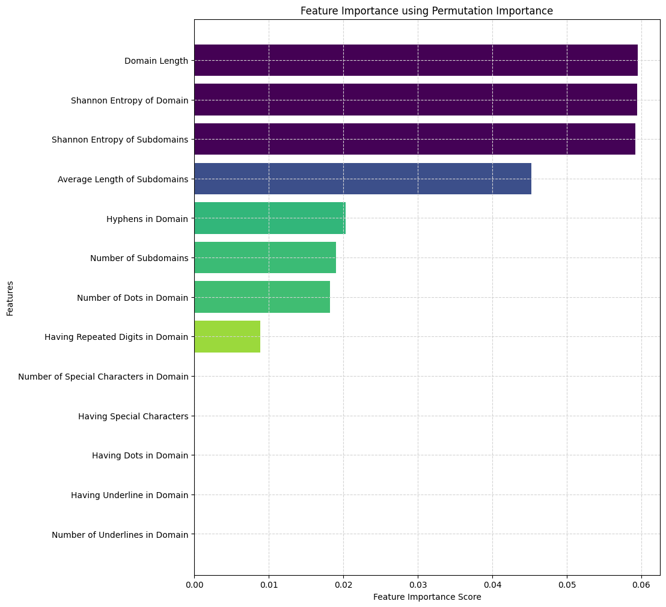
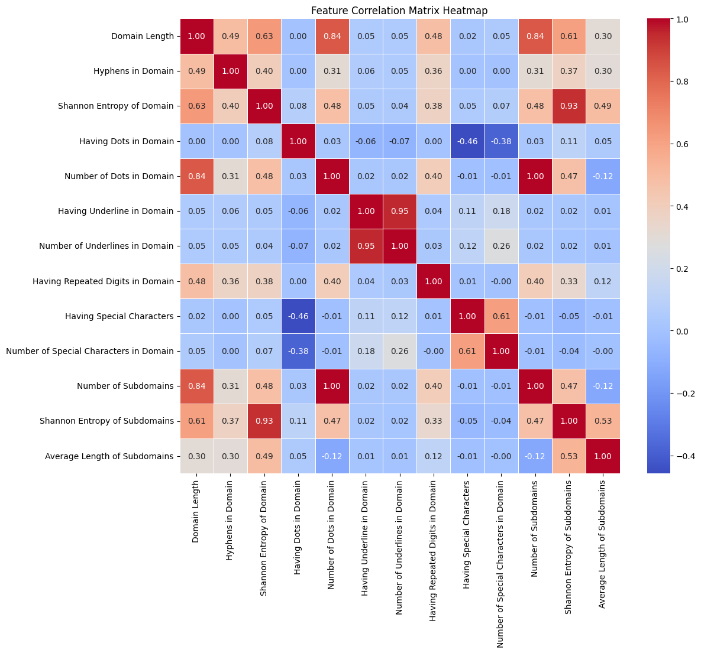
FEATURE IMPORTANCE

Slide 11
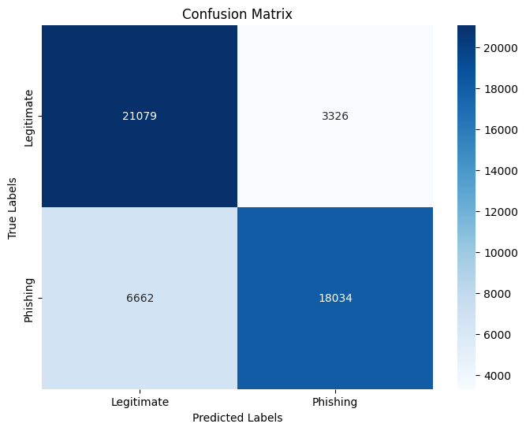
KEY FINDINGS
THE FINAL MODEL (BEST PERFORMER-RANDOM FOREST)
Class | Precision | Recall | F1-Score | F1-Score | Support | Training Time | Testing Time
0 | 76% | 86.4% | 80.8% | 80.8% | 24405 | 33.03 seconds | 1.9 seconds
1 | 84.4 % | 73.0% | 78.3% | 78.3% | 24696
5-fold CV Accuracy | 80.2%
Accuracy | 80.3% |  |  |  | 49101
Macro avg | 80.2% | 79.7% | 79.6% |  | 49101
Weighted avg | 80.2% | 79.7% | 79.6% |  | 49101

Slide 12
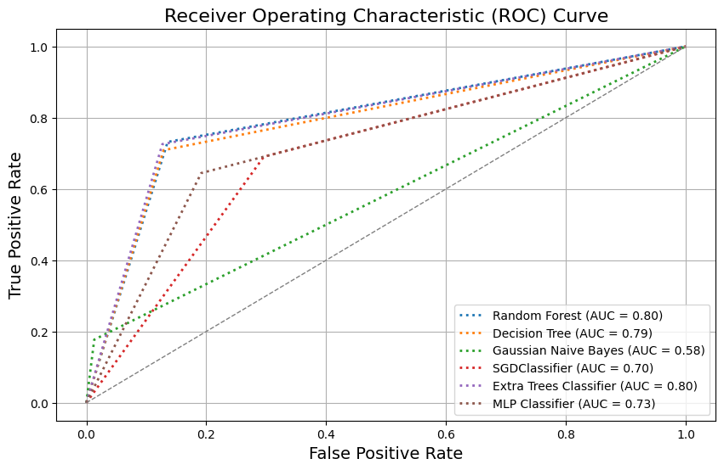
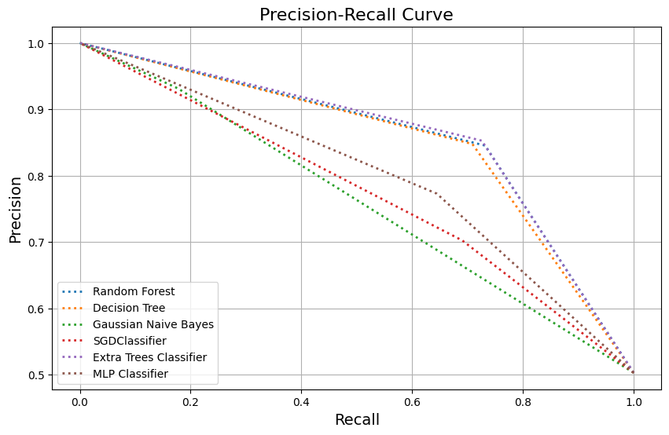
KEY FINDINGS
THE FINAL MODEL (BEST PERFORMER-RANDOM FOREST)

Slide 13
TAKE-HOME NOTES
Phishing is a major cyber threat with evolving tactics that challenge detection methods.
Key Algorithms Compared: Random Forest (RF), Decision Tree (DT), Gaussian Naive Bayes (GNB), SGDClassifier, Extra Trees (ET), Multilayer Perceptron (MLP).
Algorithm Performance:
Random Forest (RF): Strong overall performance (80.3% accuracy), balanced precision/recall, but high false negatives (6,662).
Extra Trees (ET): Similar to RF, with slightly fewer false negatives; ensemble methods are effective.
Decision Tree (DT): Quick, but higher false negatives, making it less efficient than RF/ET.
Gaussian Naive Bayes (GNB): Poor performance (58.8% accuracy), imbalanced recall, not suitable for minimizing false negatives.
MLP & SGD: Moderate accuracy (72.5% and 69.7%), but prone to high false positives and negatives.
Comparison with Previous Studies:
Higher accuracy in previous hybrid models (e.g., Korkmaz et al. 2022), but those studies used smaller, imbalanced datasets.
Large dataset and cross-validation in this study provide a more comprehensive evaluation of ML algorithms. Computational efficiency was evaluated, highlighting the need for low-latency models in real-time phishing detection.
Future Directions: Focus on optimizing neural network models and exploring hybrid approaches for improved accuracy and efficiency.

Slide 14
Thank you

